Slide 1


Slide 2
What is depth first search?
-its an algorithm for traversing or searching tree or graph data structures.
-The algorithm starts at the root node and explores as far as possible
along each branch before backtracking.
-usually, a stack is needed to keep track of the nodes discovered so far
along a specified branch which helps in backtracking of the graph.

Slide 3
Things to know
-start from the root or any arbitrary node and mark the node and move to the adjacent
unmarked node(there is no source vertex).
- In DFS every node has a discovery time and a finished time.
-d[u] ← discovery time : The discovery time d[v] is the number of nodes Discovered
or finished before first seeing v .
-f[u] ← finishing time : The finishing time f[v] is the number of nodes discovered or
finished before finishing the expansion of v .

Slide 4
Things to know
- Every node have a color either its white , gray or black.

Slide 5
Things to know
-Every color have a meaning.

Slide 6
Things to know
Let us see an example!

Slide 7
Things to know
a node will be colored white when
its not visited yet.
Notice there is no discovery time or
Finishing time in the node.

Slide 8
Things to know
a node will be colored gray when its visited for the first time.
When its first visited an discovery time
Will be initialized to that node.
Just that easy!
Time + 1
time

Slide 9
Things to know
Things to know
a node will be colored black when all of its adjacent has been visit.
When a reached node have no more
Adjacent then it will be colored black
And a finish time will be initialized.

Slide 10
Things to know
Let us see an example!

Slide 11
Things to know
Dtime
Dtime
Here is our example let us see
How its gone work
Ftime
Ftime
W
u
Lets chose node V path
so Is there any more adjacent ?
No there is not
Yes there is
so Is there any more adjacent ?
No there is not
Since there is no more adjacent
We will color the node in black
And initialize a finish time.
so Is there any more adjacent ?
Now go through node W path
Dtime
Same on node U and so on
Ftime
Every node will check if there is any adjacent nodes
Connected with if there is no more adjacent node A finish
time will be initialized and it will be colored black.
V

Slide 12
Things to know
Just that easy !

Slide 13
Things to know
There are a multiple type of edges we will
Deal with
ladies and gentleman
Let me introduce for you
THE EDGE CLASSIFICATION!

Slide 14
THE EDGE CLASSIFICATION
1- Tree edge : will appear when you visit
a white node.
It looks like this →

Slide 15
THE EDGE CLASSIFICATION
2- Back edge : will appear when you visit
a gray node.
It looks like this -->

Slide 16
THE EDGE CLASSIFICATION
3- Forward edge : will appear when you visit a black node.
It looks like this -->
f
Notice that we write an f Ander
The forward edge

Slide 17
THE EDGE CLASSIFICATION
4- cross edge : will appear when you visit a node b from a node a. and d[a] > d[b].
It looks like this -->
C
Notice that we write an C Ander
The crros edge

Slide 18
Now lets get into the
Real matter
The algorithm

Slide 19
The algorithm
There is two algorithm that will be
Applied here :
1- DFS(V,E)
2- DFS-VISIT(U)

Slide 20
The algorithm
DFS(V,E)
DFS-VISIT(u)
for each u ∈ V
do color[u] ← WHITE
π[u] ← NIL
time ← 0
for each u ∈ V
do if color[u] = WHITE
then DFS-VISIT(u)
color[u] ← GRAY
time ← time+1
d[u] ← time
for each v ∈ Adj[u]
do if color[v] = WHITE
then π[v] ← u
DFS-VISIT(v)
color[u] ← BLACK
time ← time + 1
f[u] ← time

Slide 21
The algorithm
DFS(V,E)
for each u ∈ V
do color[u] ← WHITE
π[u] ← NIL
time ← 0
for each u ∈ V
do if color[u] = WHITE
then DFS-VISIT(u)
-The whole idea of this algorithm Is to initialize every node
And Make sure that every node have Been visited.
-Every time DFS-VISIT(u) is called, u becomes the root of a new tree in the depth-first forest.
-from 1to 4 its an initialization matter for every node.
-from 5 to 7 we create a path from a starter node where
It should be white.

Slide 22
The algorithm
DFS-VISIT(u)
color[u] ← GRAY
time ← time+1
d[u] ← time
for each v ∈ Adj[u]
do if color[v] = WHITE
then π[v] ← u
DFS-VISIT(v)
color[u] ← BLACK
time ← time + 1
f[u] ← time
-from 4 to 7 its going to walk in the paths of the adjacent
Node of the starter node , and every adjacent node we
Are on by this algorithm it will be the starter node and
We will do that again and again recursively until no more
Adjacent node is available then 8 and 9 will execute and
Go back recursively until no more node available.
-The whole idea of this algorithm is to start a path from a
node we received from DFS(V,E) and apply the algorithm
on it .
-from 1 to 3 its going to give the initial properties to the
Starter node.
-time is global variable increasing by 1 at every move and either we store it at discover time or finish time.

Slide 23
Now lets see a real example !

Slide 24
Now lets apply the algorithm on this graph
Here is a graph
U
V
B
A
X
Y
W

Slide 25
First we need a stack

Slide 26
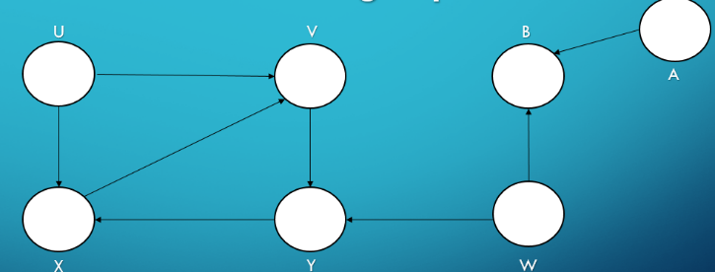
A
W
A
1
5
4
12
c
B
2
6
Y
3
11
U
c
13
f
14
By the algorithm now we will
Search for a white node and
Start a new path , assume it is W
7
X
And so on applying
The algorithm
10
Stack
Same on node A
Remove node B from stack
Add node A to stack
Add node B to stack
Assume A is a starter node
Choose node B path as an adjacent of A
Choose node B path as an adjacent of A
There is no more adjacent nodes for node B
c
8
V
9
V
X
Y
B
U
W
A

Slide 27
And that’s it ☺
Just that easy ,we hope you enjoyed

